Slide 1




CYCLISTIC BIKE-SHARE ANALYSIS
CAPSTONE PROJECT BY: AKHILA.R
BATCH CODE: MBE7
COURSE: ZEN BADM
TOOLS USED: PYTHON (GOOGLE COLAB), POWER BI, EXCEL-POWER QUERY.

Slide 2
BUSINESS STATEMENT:
“maximizing the number of annual members can lead to company’s future success”
In order to support the above statement that maximizing the number of annual members can lead to company’s future success, we conduct analysis of how casual and members use cyclistic bikes. And design a new marketing strategy based on the insights driven from the analysis.

Slide 3
Processing the data:
Downloaded the data and stored it as excel workbook.
Data has information about the rider id, starting time and location/ station and ending time and location of the trip.
The data is about the rides taken in the month of september 2020.
Imported the data into google colab for processing the data with the help of python programming language.
The data has 532958 rows and 13 columns.
The rider types: casual and annual membership holders.
Types of bikes: Electric and Docked bikes.

Slide 4
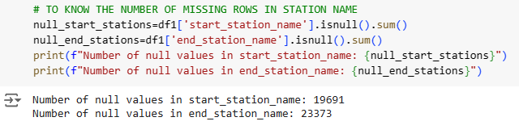
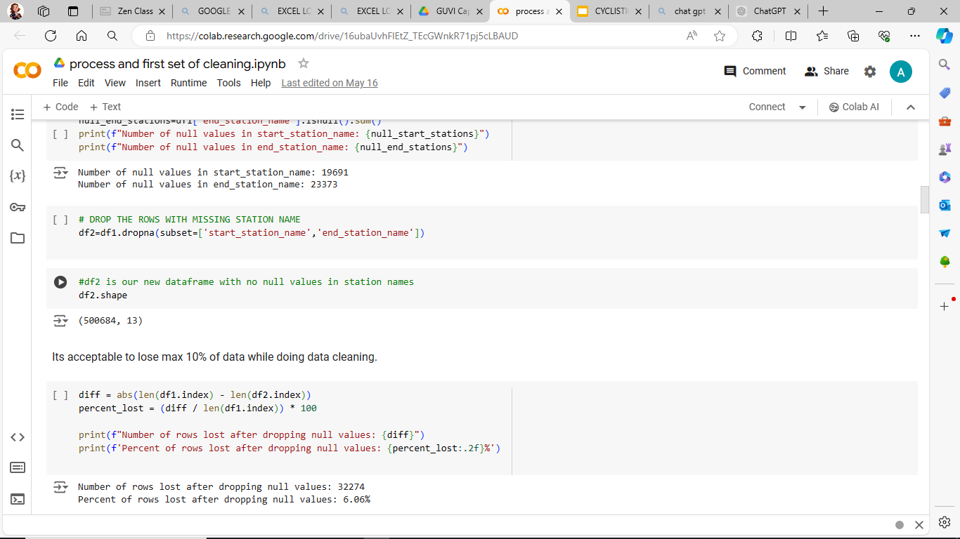
Cleaning: Removing NULL values
NULL values or missing entries are seen only in the station information columns.
Find the NULL values in station_names and remove them.

Slide 5
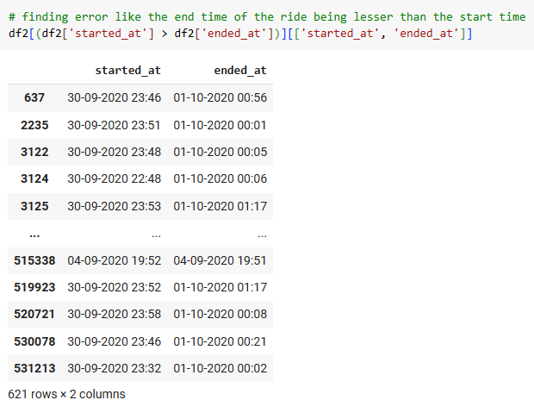
Cleaning: Errors in Data
In 621 entries the end time/date was lesser than the start date/time. Eg: start- 2:09pm end: 2:08pm
This might be an human error or glitch in the system.
In this case the entries in start time was transferred to end time and vice versa. Assuming that the start time being the end time.

Slide 6
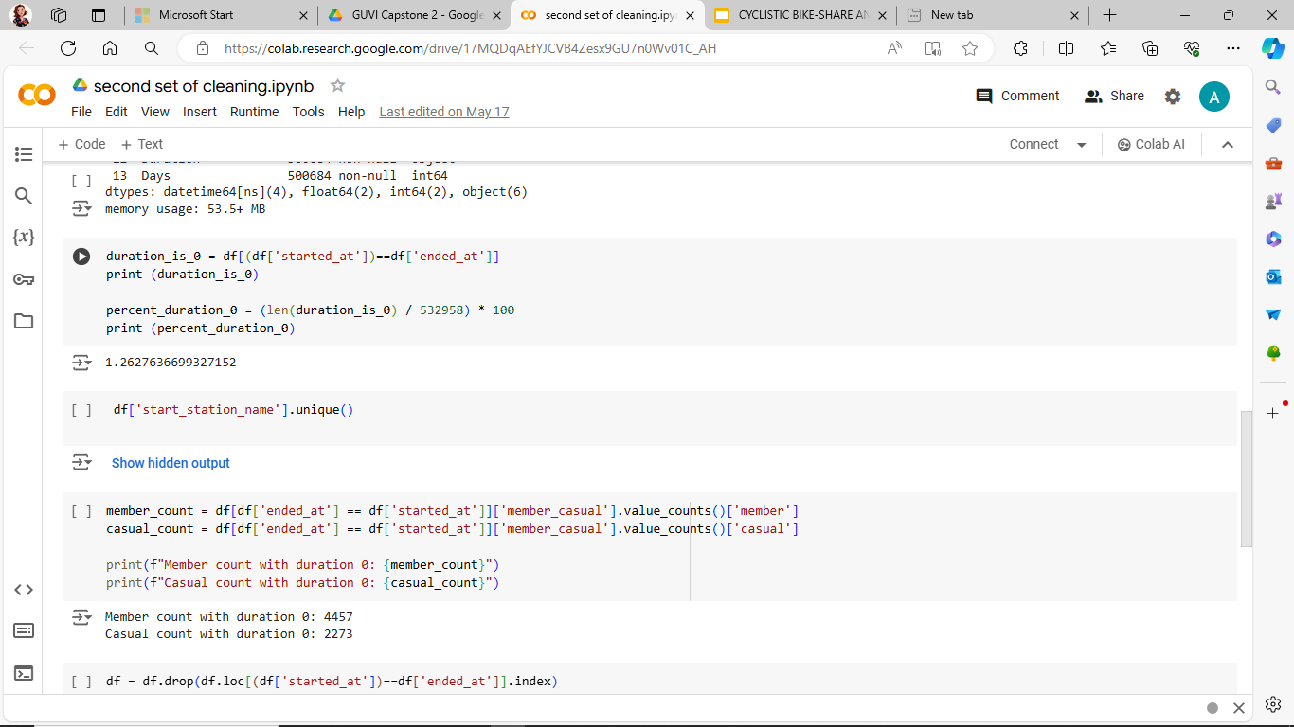
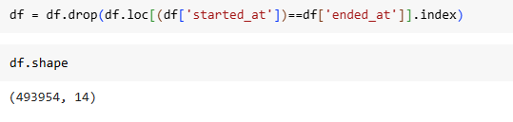
Cleaning: dropping rows with 0 duration
In some entries (1.6% or 6730 rows) we can observe that the ride duration is 0. I.e: the start time and end time is the same.
This can happen due to system errors or extremely lower ride duration which is lesser than a minute. Or due to cancellation of the ride after starting it.
Assuming that it can be an error or due to ride cancellation we drop these rows.

Slide 7
Summary of Cleaning:
After checking the data for null values. We removed 6.06% of data.
When checking for errors we exchanged the values of started_at and ended_at columns where the end time was lesser than start time.
We removed 1.6% data where the duration was 0.
Totally in cleaning process we have removed 7.66% of data with errors and abnormalities.
Now we are left with 493954 rows.

Slide 8
Post Processing:
After cleaning the data store it in a excel workbook. And open power query editor.
Create Duration column by subtracting start time from end time. For ease of visualization break the columns into days and hours.
In order to optimize the data remove columns that wont be used in visualizations: start and end station id, start and end station name.
Since we have found the duration, start time and end time won't be used in analysis. Break the started_at and ended_at column into date and time and remove the time data.
Removing columns can speed up loading data in Power BI.

Slide 9
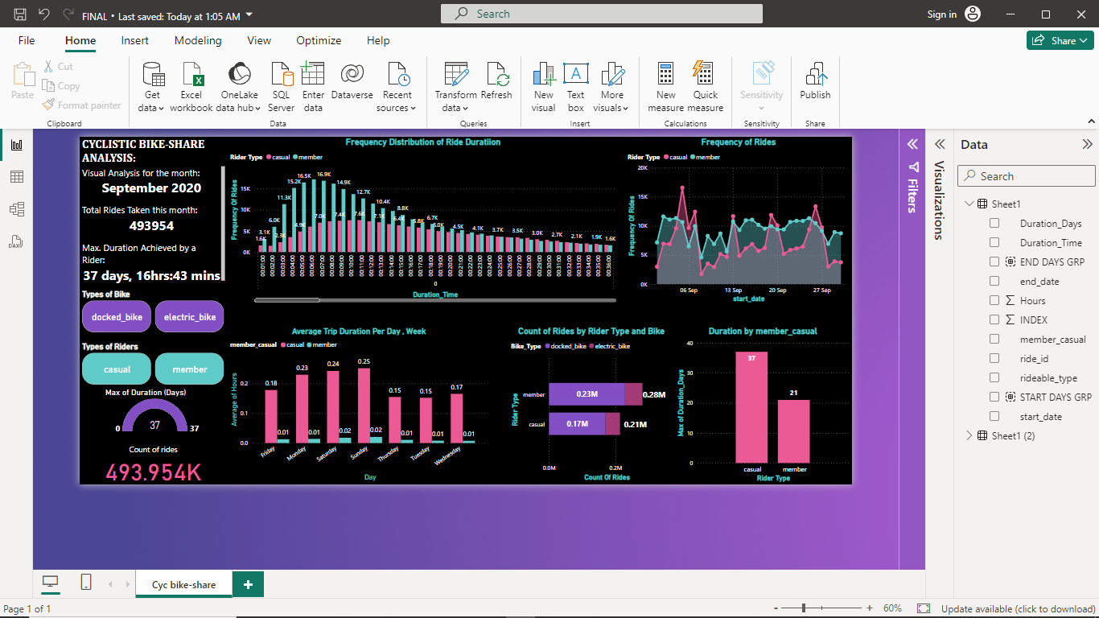
Analysis:
During the month of september 2020 the rides taken by members (0.28M)are more than casuals(0.21M).
Most used bike is docked bike. Around 97% of the riders preferred docked bike over electric bikes.
The maximum ride duration of a casual is 37 days and member is 21 days.

Slide 10
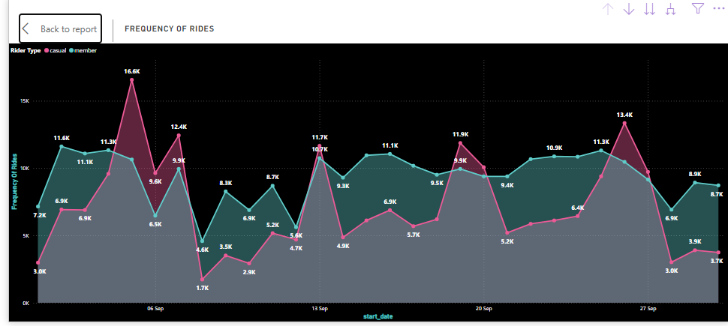
Frequency of rides per day:
We can observe that the annual members are almost consistent in using cyclistic bikes throughout the month.
Where as casuals use cyclistic bikes more only during some days.

Slide 11
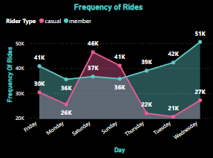
Frequency of rides per Day:
Here when we can clearly see that the annual members use cyclistic bikes more during weekdays (working days) and lesser during weekends.
Casuals tend to ride more during weekends only. i.e: Saturday and Sunday.

Slide 12
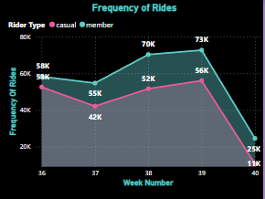
Frequency of rides per week:
Members use cylistic bikes more than casuals every week.

Slide 13
Summary:
Casual riders: tend to use the bikes only during weekends (saturday and sunday).
Annual members: tend to use rides on weekdays or working days. They consistently use bikes throughout the month.
Overall when we see the rides taken each week , frequency of members are always higher than frequency of casuals.

Slide 14
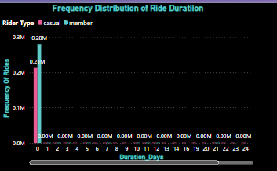
Frequency distribution of ride duration:
Almost 99.94% of riders use bikes for lesser than 1 day duration.

Slide 15
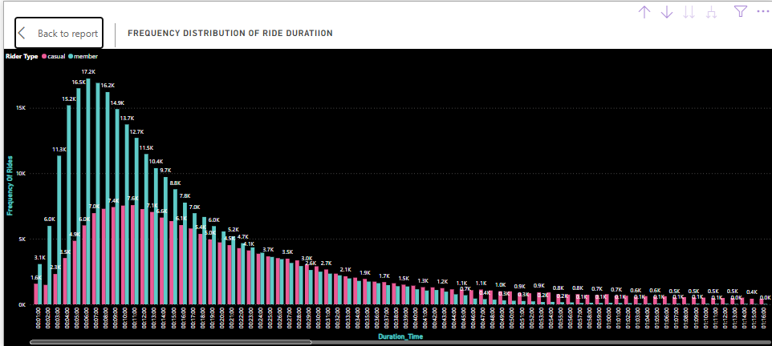
Frequency distribution of ride duration:
Most of the riders tend to use the bikes for lesser durations varying from 1 minute to 1 hour :13 minutes.
Members use bikes for 1 to 45 minutes with max. frequency seen in 6 minutes. Around 17.2k annual members tend to use bikes for 6 mins duration.

Slide 16
Frequency distribution of ride duration:
Casual riders tend to use bikes for 1min to 1hour 13mins.
Around 7549 casual members use bikes for 11 mins.
In fact after a certain duration casuals dominate the members in ride duration. Which is after 25mins we can see casuals use bikes for more duration than annual members.

Slide 17
Summary:
99.96% of riders use bikes for a duration of lesser than one day.
Lesser the duration more the count of riders. Which is 1min to 1hr:45mins.
More the duration more the count of casual using the cyclistic bikes than members.
Members use bikes for daily commutes which is in range of 1 to 45 mins.
Casuals use bikes more for longer durations like 1h:45mins and more.

Slide 18
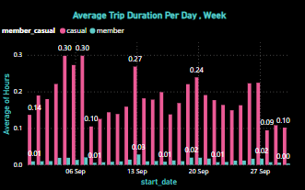
Average Trip duration per day:
We can see that the average trip duration of a casual rider is more than a annual member at any day of the month.
Casual’s average ride duration: 5 minutes to 18 minutes.
Member’s average ride duration: lesser than 36secs to 1m:48s.

Slide 19
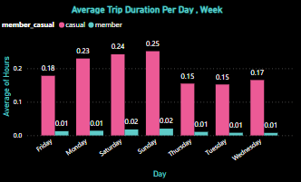
Average Trip duration per day:
Average trip duration of casual rider is more on weekends- saturday and sunday.
Casual’s avg. trip duration: 9 minutes to 15 minutes.
Average trip duration of an annual member is significantly lower than a casual rider.
Member’s avg. trip duration: 36 seconds or 1 minute: 12 seconds.

Slide 20
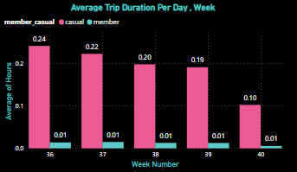
Average Trip duration per week:
The average trip duration of casuals are higher in the first week (14m:24s) and gradually decreases every week. Comes to 6 minutes in the last week of september.
The avg. trip duration of a member stays 36s on all the 5 weeks of september.

Slide 21
Summary:
The average ride duration of a casual rider stays significantly higher than the avg. ride duration of an annual member.

Slide 22
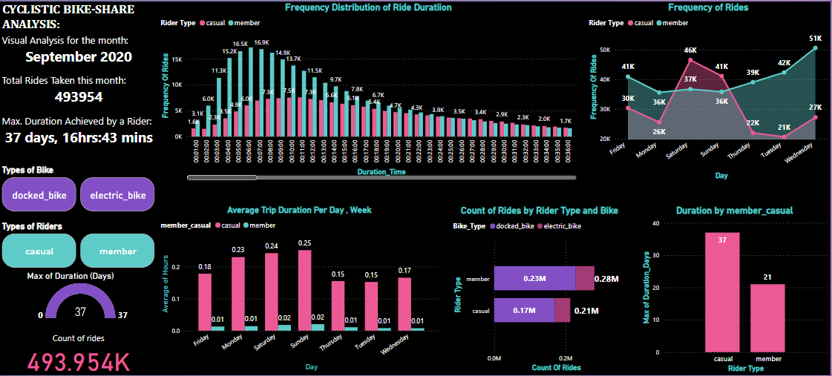
DASHBOARD:

Slide 23
OVERALL SUMMARY: will targeting casual riders bring profit?
From the analysis we can clearly see that the existing members use bikes only for shorter duration but more frequently.
Where as casuals use bikes mostly on weekends and they use their bikes for longer durations.
Catering to the needs of these casual riders and converting them into annual members can surely bring profit from the aspect of bikes being used for longer duration.

Slide 24
RECOMMENDATIONS BASED ON THE ANALYSIS:
Memberships offering lesser prices for increased ride durations (to cater the casuals using bikes for longer duration)
Memberships should also offer lesser price on rides taken on weekends (to cater the high weekend casual riders).
We must publish these offers during the week days and offer a promotional discount running throughout the month/week in order to gain the attention of casuals.

Slide 25


